Slide 1

Notes:
1

Slide 2

Rock Talk
I’m not lettin’ those – rocks talk;
not as long as I can speak!
I’ll tell how good God has been
to me and my family!
He’s given us more than we need-
and a safe place to sleep.
No, I’m not lettin’ those -- rocks talk,
when God’s been good to me!
He loves me even though I sin,
and say things I shouldn’t say.
He forgives me as I confess to Him,
when I take the time to pray!
No. I’m not lettin’ those – rocks talk,
I’ll speak of amazing grace,
and live my life so others can see-
it’s through Jesus I am saved.
Written by De Dorman ©2025

Slide 3
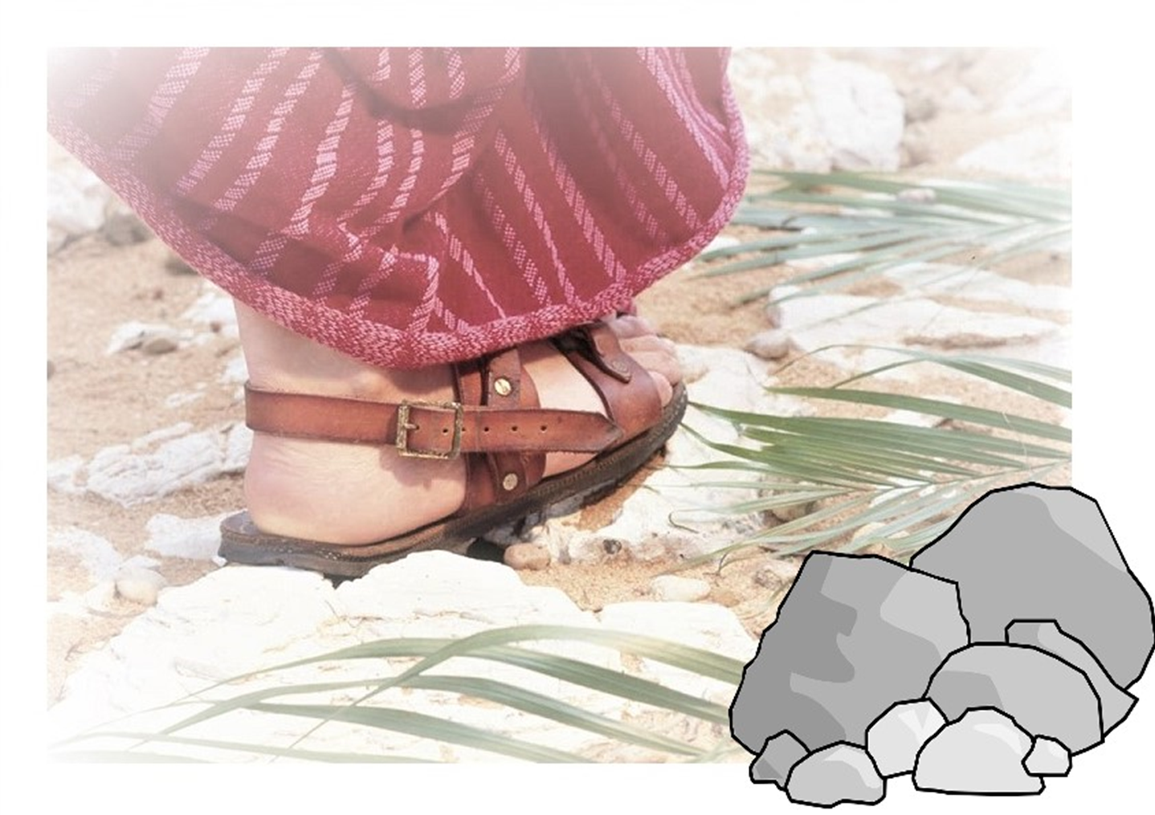
Luke 19:39-40
Notes:
3

Slide 4
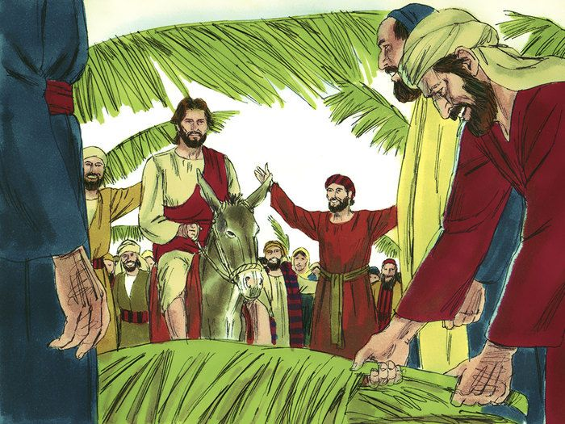

“Hosanna!
Blessed is He who comes in the name of The LORD!”
And some of the Pharisees called to Him from the crowd. “Teacher, rebuke Your disciples.” But He answered and said to them, I tell you that if these should keep silent, the stones would immediately cry out.”
Hosanna means- (You have come to) save us. It’s an expression of high praise and joy.

Slide 5
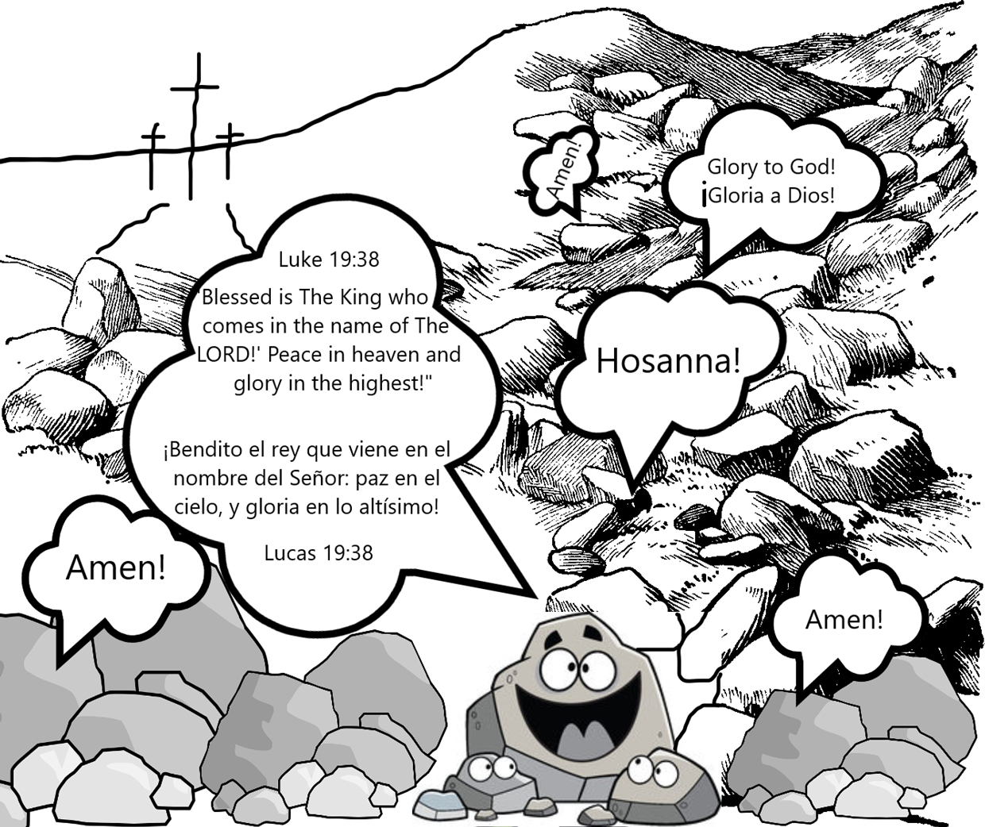

Slide 6
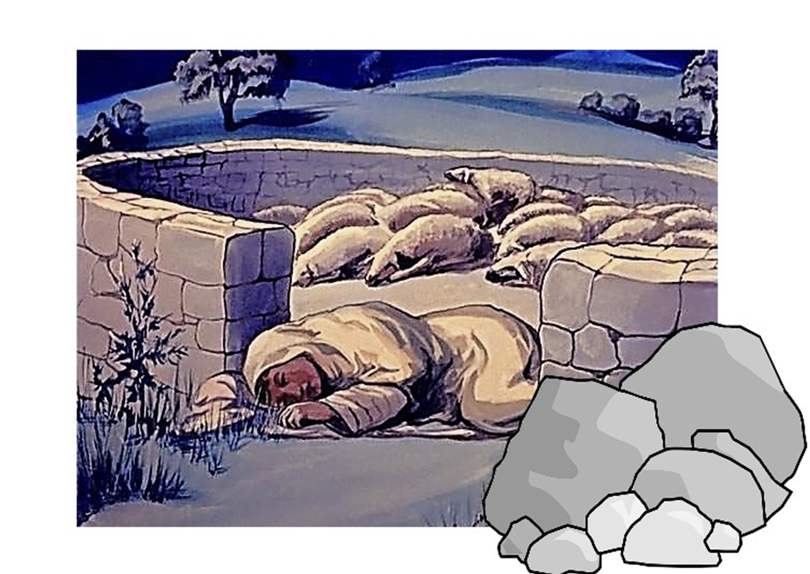
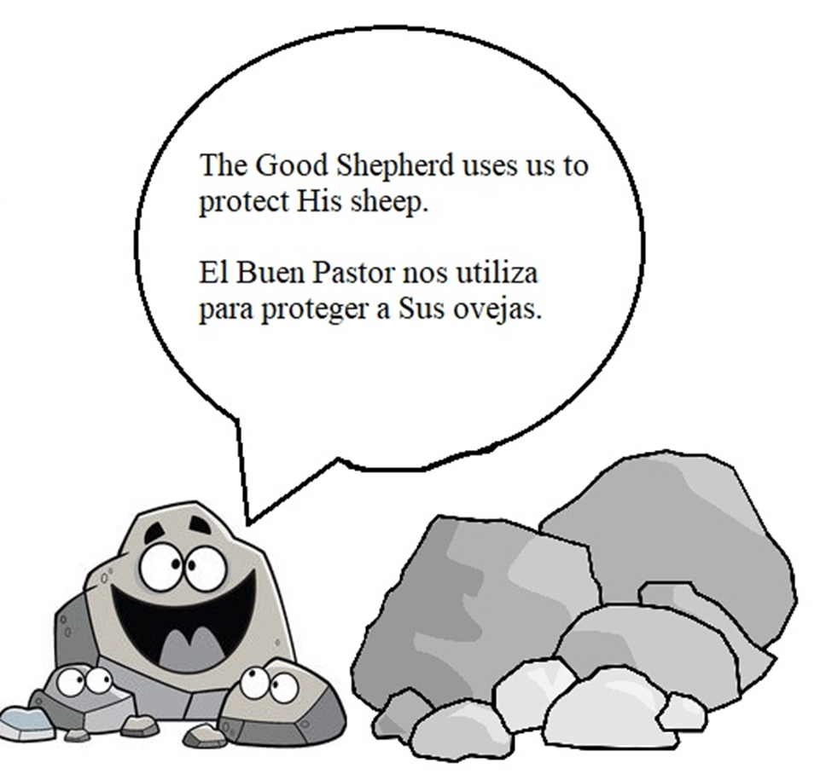

Slide 7
Psalm 18:2
“The Lord is my rock and my fortress, and my deliverer; my GOD, my strength, in whom I will trust.”

Slide 8
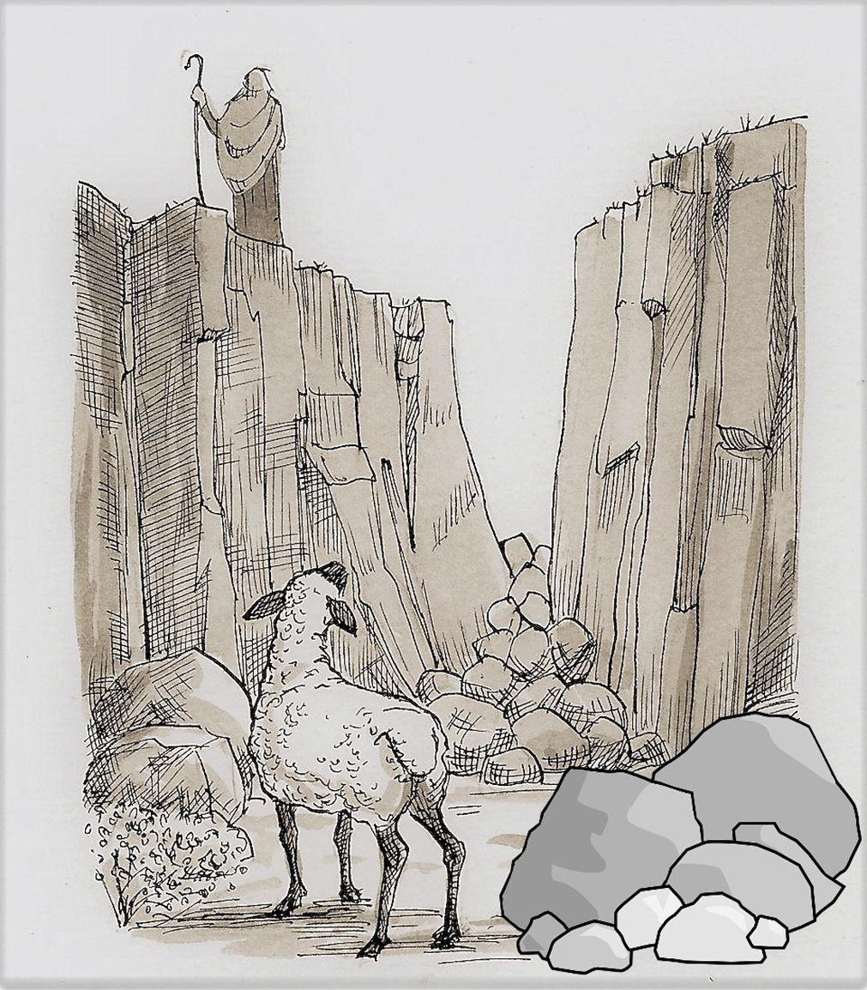
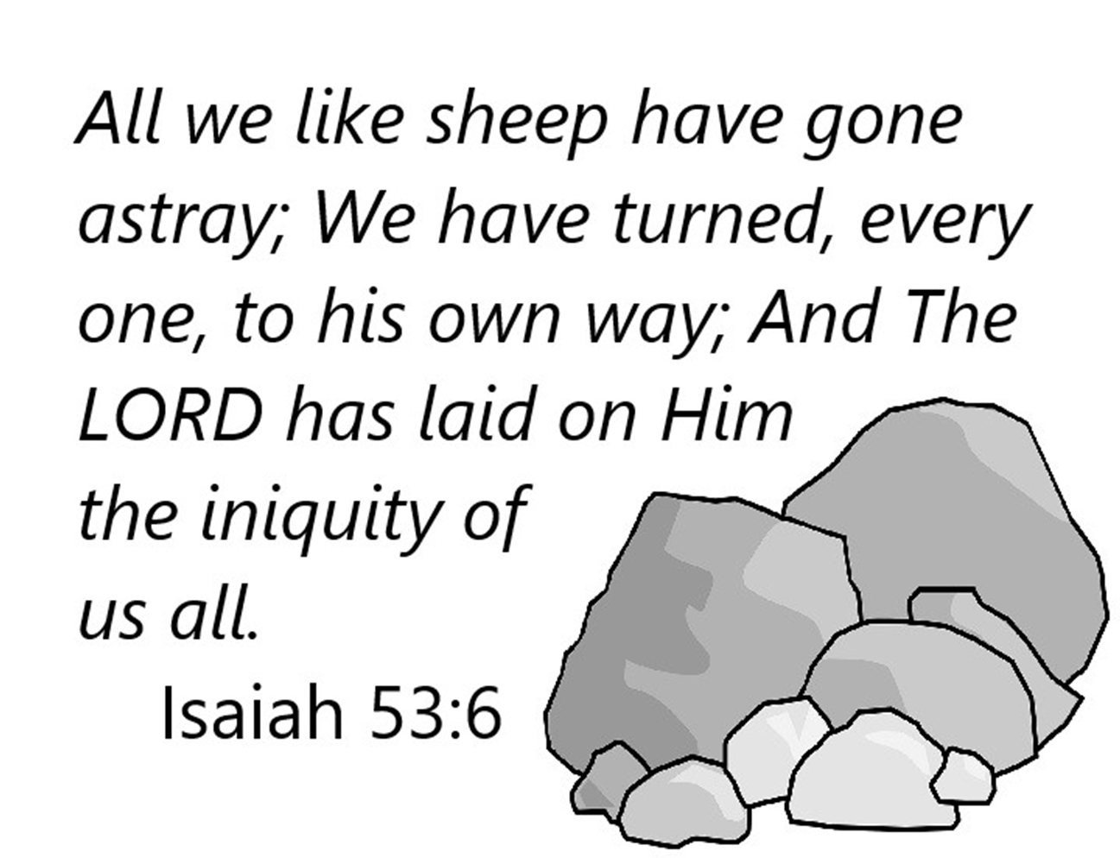

Slide 9

I Timothy 1:15
“Christ Jesus came into the world to save sinners, of whom I am chief.”
You will know who is saying that he is worst sinner of all if you know who wrote the Book of I Timothy.

Slide 10
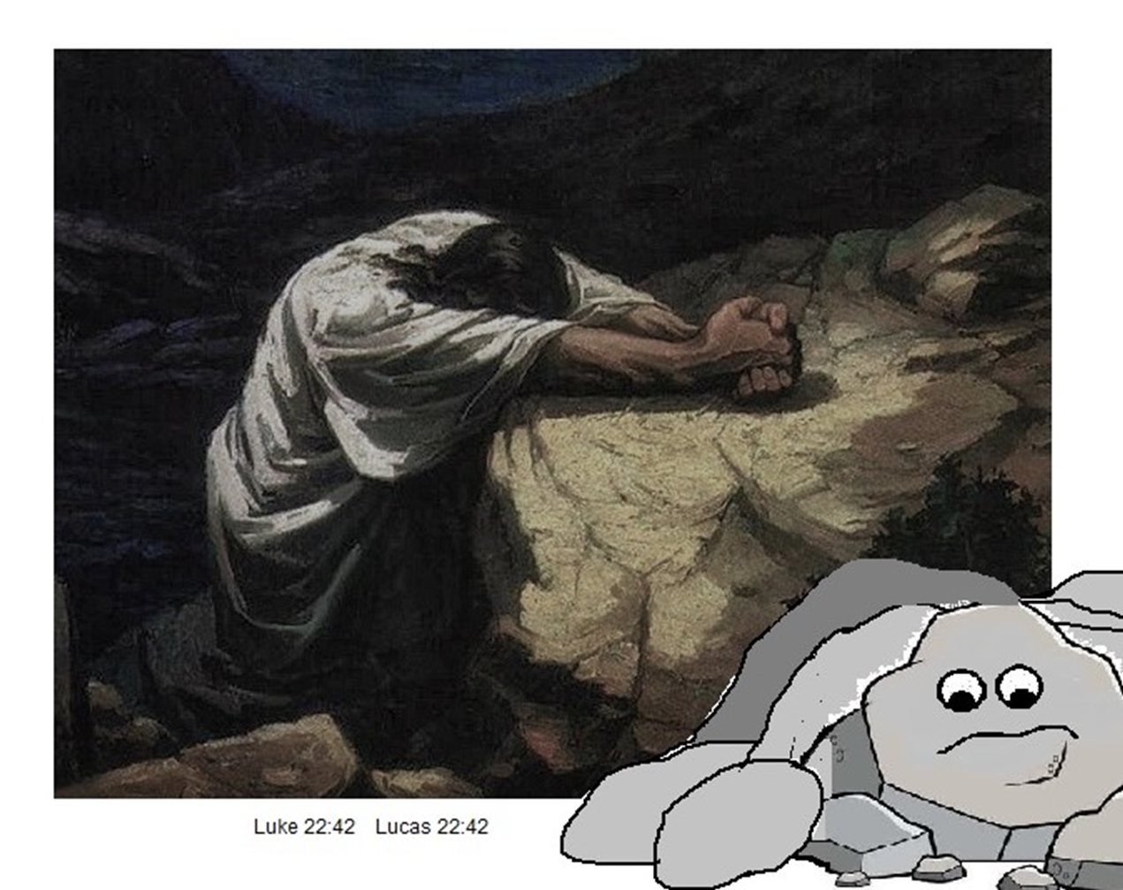

Slide 11

Matthew 26:39 “Oh, Father, if it is possible, let this cup pass from Me, nevertheless, not as I will, but as YOU will.”
Matthew 26:41 Watch and pray lest you enter into temptation. The spirit indeed is willing, but the flesh is weak.”

Slide 12
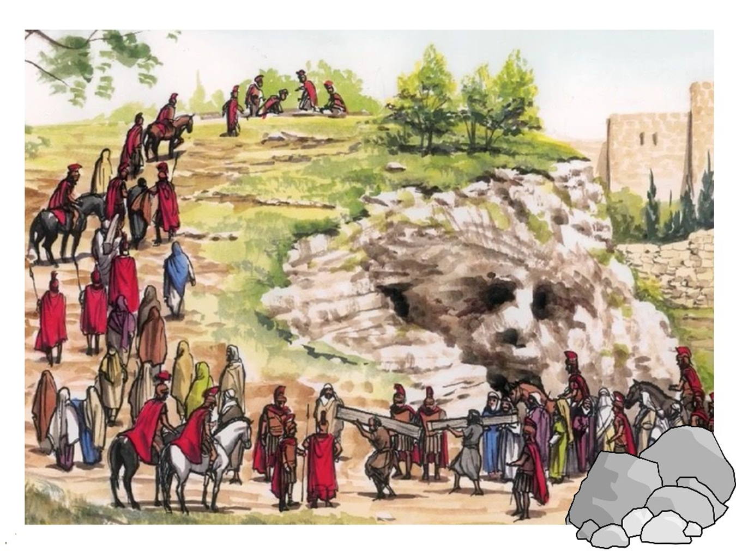

Slide 13
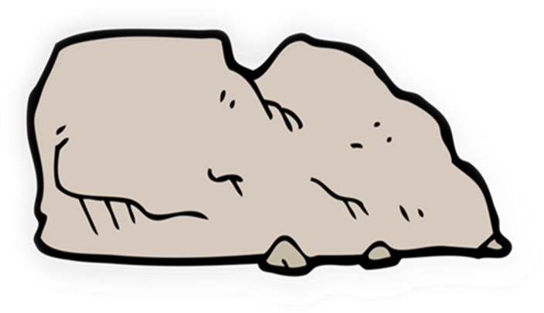
I Peter 3:18
“Christ also suffered for sins once for all, the just for the unjust, that He might bring us to GOD..”

Slide 14
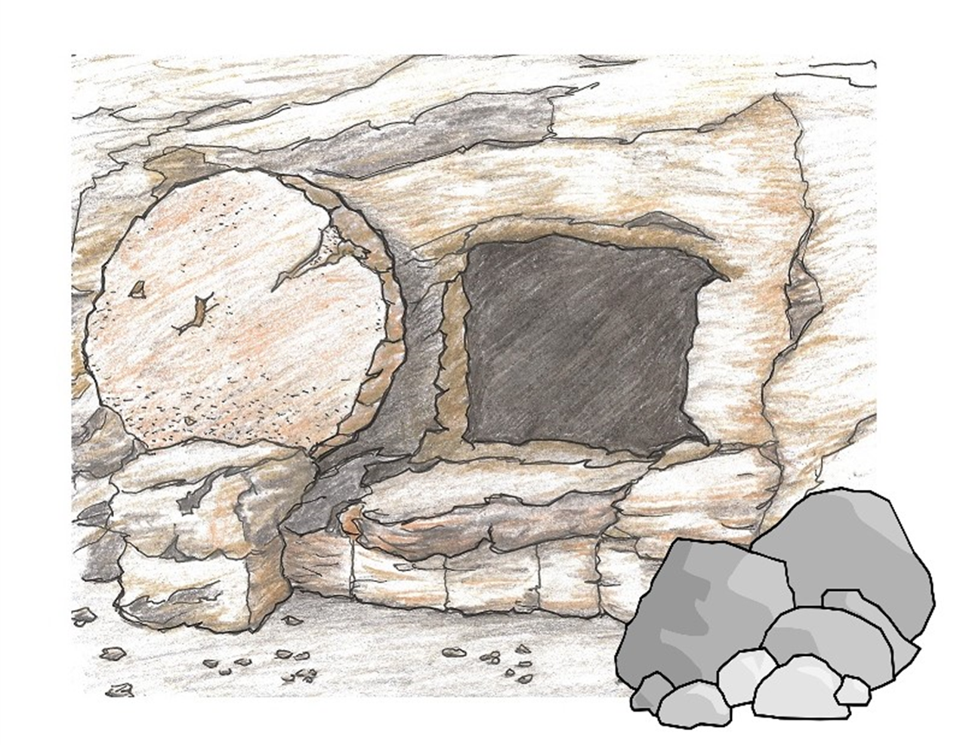

Slide 15
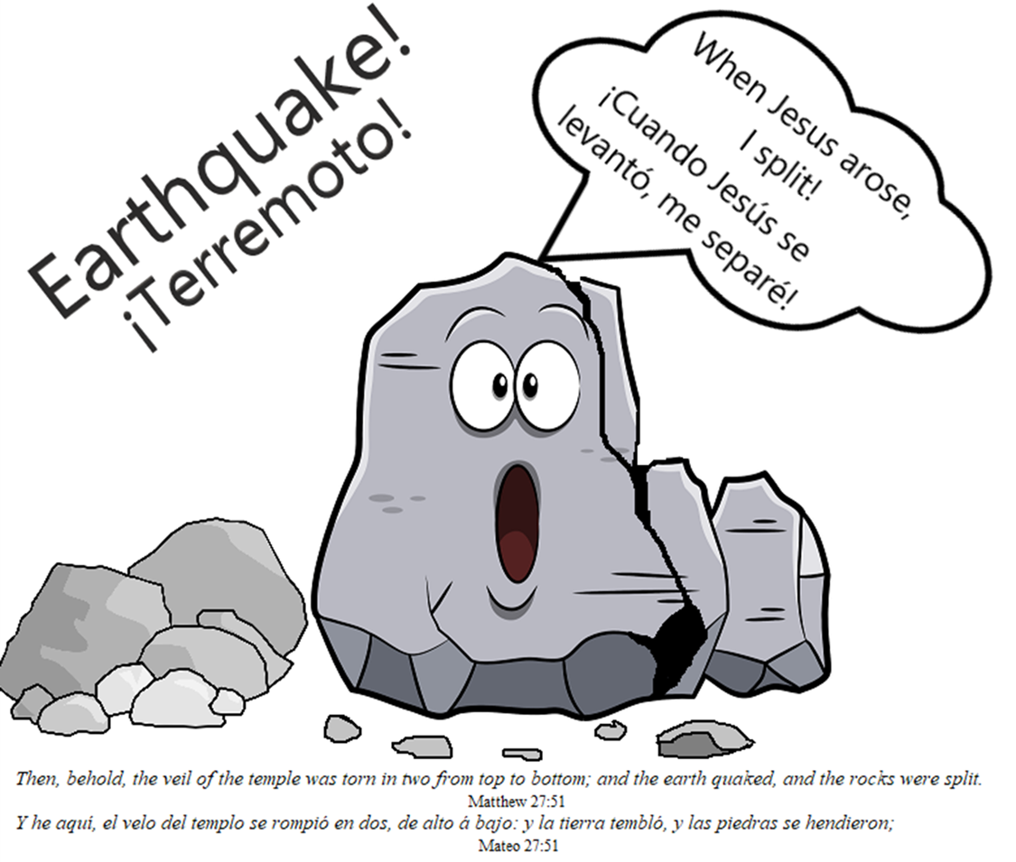

Slide 16
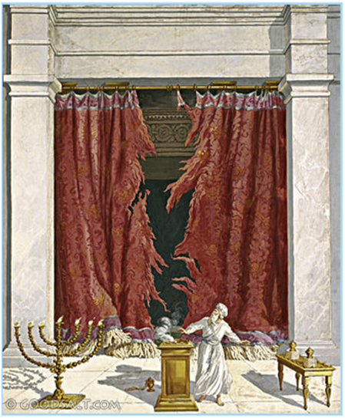

Then, behold, the veil
of the temple was torn in two from top to bottom; and the earth quaked, and the rocks were split.. Matthew 27:51

Slide 17


Psalm 62:6
“He only is my rock and my salvation:”

Slide 18
Rock Talk
I’m not lettin’ those – rocks talk;
not as long as I can speak!
I’ll tell how good God has been
to me and my family!
He’s given us more than we need-
and a safe place to sleep.
No, I’m not lettin’ those -- rocks talk,
when God’s been good to me!
He loves me even though I sin,
and say things I shouldn’t say.
He forgives me as I confess to Him,
when I take the time to pray!
No. I’m not lettin’ those – rocks talk,
I’ll speak of amazing grace,
and live my life so others can see-
it’s through Jesus I am saved.
Written by De Dorman ©2025

