Slide 1

A Teacher’s Heart Workshop
El Corazón de un Maestro

Slide 2

Zechariah 4:6
Zacarías 4:6 No con ejército, ni con fuerza, sino con Mi Espíritu, ha dicho Jehová de los ejércitos.

Slide 3


Bible teaching is a work of the spirit which requires the teacher to be filled with the spirit.
Enseñanza de la Biblia es una obra del espíritu que requiere el profesor ser lleno del espíritu.
Ephesians 5:18
And be not drunk with wine, wherein is excess; but be filled with The Spirit;
Efesios 5:18 Y no os embriaguéis de vino, en lo cual hay disolución; mas sed llenos de Espíritu;

Slide 4

Daily time with God..Don’t teach without it!
Tiempo diario con Dios...¡No enseñar sin él!
The people God uses to change the world are the people that the world cannot change!
Las personas que Dios usa para cambiar el mundo son las personas que el mundo no puede cambiar!

Slide 5

Pray for God to work in the hearts of your students. Mention their names.
Orar a Dios para trabajar en los corazones de sus estudiantes. Mencionar sus nombres
James 5:16
Confess your faults one to another, and pray one for another, that ye may be healed. The effectual fervent prayer of a righteous man availeth much.
Santiago 5:16
Confesaos vuestras faltas unos á otros, y rogad los unos por los otros, para que
seáis sanos; la oración del justo, obrando eficazmente, puede
mucho.
Person who is right with God
Una persona que está bien con Dios
If we would confess our faults to one another and pray instead of pretending everything is OK, there would come a
healing between brethren, in classes and churches.
Si nos confesamos nuestras faltas unos a otros y orar en lugar de fingir que todo está bien, vendría un cura entre
hermanos, en las clases y las iglesias.

Slide 6
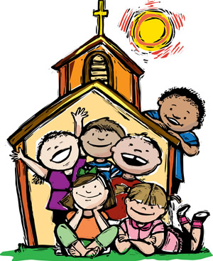
“Therefore, my beloved brethren, be ye stedfast, unmoveable, always abounding in the work of The Lord, forasmuch as ye know that your labor is not in vain in The Lord.”
“Así que, hermanos míos amados, estad firmes y constantes, creciendo en la obra del Señor siempre, sabiendo que vuestro trabajo en el Señor no es vano.”
1Cor. 15:58

Slide 7
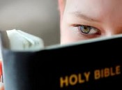
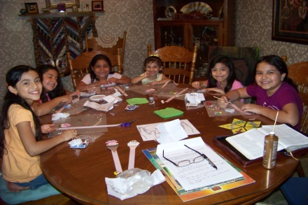
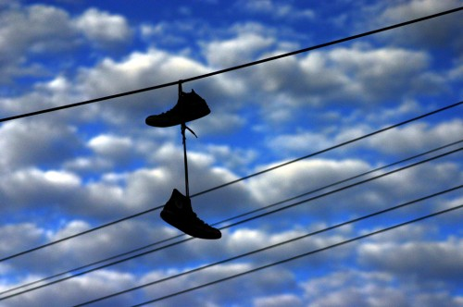

Window of opportunity!
Ventana de oportunidad
Ephesians 5:16 “Redeeming the time for the days are evil.”
Efesios 5:16
“Redimiendo el tiempo, porque los días son malos.”
In April 1855 D.L. Moody was saved when his Sunday School, , Edward Kimball, spoke to about how much God loved him. He was 17 years old.
There is no limit to what can be done if it doesn’t matter who gets the credit!
At what age did you come to know Christ as Savior?
No hay límite a lo
que se puede hacer
si no importa quién
reciba el crédito!
Aspire to inspire before you expire!
¡Aspira a inspirar antes de que caduque!

Slide 8

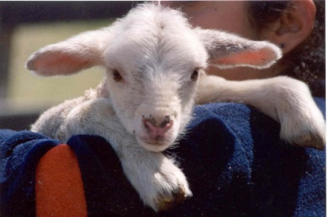

Remembering a Special Sunday School Teacher
It's easy to remember the number of times I attended church as a child, usually on Easter Sunday and maybe one or two VBS’s.
What stands out so clearly, at one particular church, is seeing a kind teacher's smile when we entered her class room. The songs that we sang
were happy songs. She not only read from The Bible, she and her assistant patiently handed out extra Bibles for all the children to see the verses
and read along. It was in her class, at the age of 8, that I read John 3:16 for the first time. My sister and I only attended her class a few times,
each occasion was Easter Sunday, but The Lord used this Spirit-filled teacher in a way that would impact the rest of my life. Upon our second visit,
she handed me a beautiful red Bible to read from. This one, however, was different than all the other loaner Bibles; it had my name engraved at the
bottom in shiny gold letters. After telling the teacher, she gently replied, “Then it must be your Bible.” It had been a whole year since I attended
her class, yet she remembered and must have been praying for me. Her kindness has remained in my heart to this day though the Bible has long since
worn out. She gave me the very things that I needed.. kindness, truth and hope! I hugged the Bible all the way home after church, thinking in my heart
that maybe, just maybe, God does know that I'm alive.
I believe that Jesus Himself was giving me what I needed through the hands of that special teacher many years ago...His Word.
Coming from a family shattered by alcoholism, God was wooing me to Himself, beckoning through this teacher.. "I love you and have wonderful plans
for your life." I finally understood, some years later, that Jesus was my substitute sacrifice for sin, and humbly accepted Him into my heart and life.
I've worn out some Bibles since then, the red one included, but none would be as special as that little award Bible many years ago.
Children today are silently crying for truth, love, hope and purpose for their lives. It is my earnest prayer that, as this lady was used by
The Lord to bring hope to my heart, we as children's workers would demonstrate that same kind of care and burden for all children who walk in our
classrooms, allowing our Heavenly Father to love them through us.
Some things I learned from my first Sunday School teacher..
Pray for the children with whom you minister. (James 5:16)
Allow Jesus to love them through you.
Jesus loves even the most unlovely child.
Make them all feel welcome..smile!
Sing joyful songs; they stay in the heart! (Psalm 100:1 and 2)
Let them see the Bible verses. (Psalm 119:105)
Use your Bible, those who can't read, can hear The Word of God.
Be prepared to teach...filled with The Spirit. (Ephesians 5:18)
Have sufficient helpers in order to assist the children in different areas.
In all that you do, point the children to Jesus! He has the master plan for their lives.
Always give an opportunity for a child to accept Christ as their Savior but never try to do the work
that only The Holy Spirit is able to do. (Proverbs 27:1) (Psalm 95:7)
12. Simply love them as He loves us...unconditionally!
Peace
Temperance
2Timothy 2:24
Psalm 18:35 “Thy gentleness hath made me great.”

Slide 9


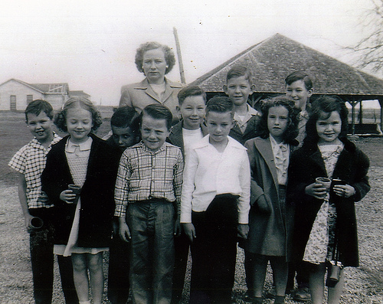
Sunday school was meant to be an outreach into communities.
Escuela dominical estaba destinada a ser una ministerio en las comunidades.
It was in England in the late 18th
Century. When Sunday School classes first began. Visionary evangelicals like Robert Raikes devised a plan to gather poor, uneducated working children into education classes on Sundays, the children’s only day
off. Bibles, clean clothes and learning
materials were provided, and
instruction given in reading, writing,
hygiene and good citizenship.
Fue en Inglaterra a finales del siglo XVIII. Cuando comenzaron clases de escuela dominical. Los
evangélicos visionarios como Robert Raikes idearon
un plan para recoger a pobres y sin educación los
niños que trabajan en las clases de educación los domingos, único día de los niños. Biblias, ropa
limpia y materiales fueron proporcionados y la
instrucción en lectura, escritura, higiene y buena ciudadanía.

Slide 10

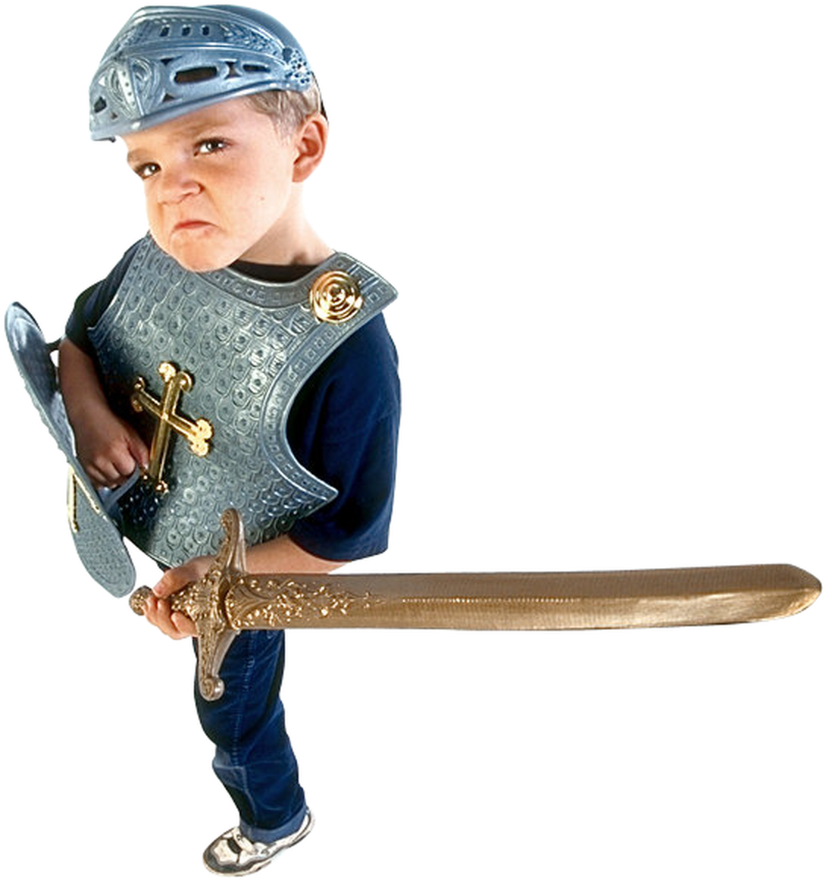
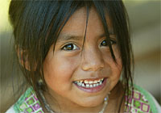
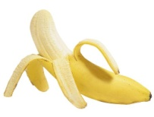
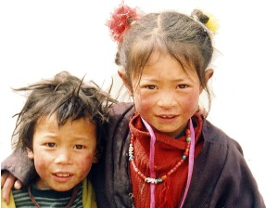



Teaching the next generation!
Volunteers read verses aloud
Love
Faith
Luke 21:33
Proverbs 22:6
Meekness
Goodness
Joy
Proverbs 20:11
John 17:17
Group discussion: Topic: The needs of the next generation List the fruits of The Spirit on the next page.

Slide 11

The transforming power of the word of god!
¡El poder transformador de la palabra de Dios!
Romans 12:2 And be not conformed to this world: but be ye transformed by the renewing of your mind, that ye may prove what is that good, and acceptable, and perfect, will of God.
Romanos 12:2 Y no os conforméis á este siglo; mas reformaos por la renovación de vuestro entendimiento, para que experimentéis cuál sea la buena voluntad de Dios, agradable y perfecta.

Slide 12

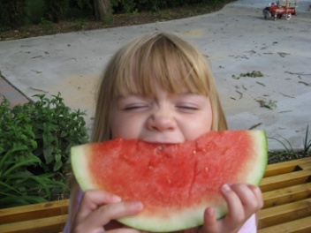
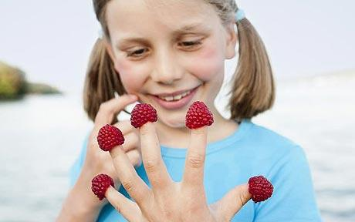
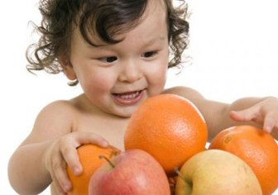

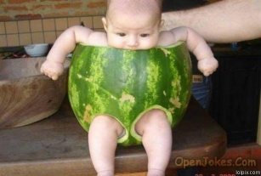
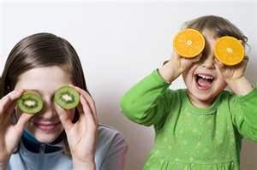
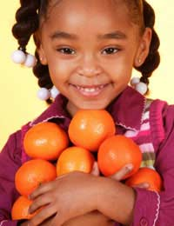

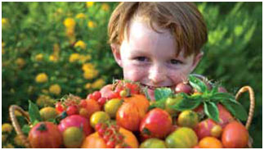
The Fruit of The Spirit
Galatians 5:;22-26
"But the fruit of The Spirit is love, joy, peace, longsuffering, gentleness, goodness, faith, Meekness, temperance: against such there is no law. And they that are Christ's have crucified the flesh with the affections and lusts. If we live in The Spirit, let us also walk in The Spirit. Let us not be desirous of vain glory, provoking one another, envying one another."
Name the
9 fruits of
The Spirit

Slide 13

Desiring God’s will
Teaching..a matter of the heart!
The believer’s heart consists of three things.
Ephesians 6:6
“Not with eye service, as men pleasers; but as the servants of Christ, doing the will of God from the heart.”
A little Greek..
Καρδία- “the center and seat of spiritual life, "the soul or mind, as it is the fountain and seat of the thoughts, passions, desires, appetites, affections, purposes, endeavors" (the inner man.)
Do I submit to God’s will for my Life?
Do I know God’s will for my life?
Intellect-
Knowing
God’s will
Do I desire God’s will for my life?
Will-
Submitting to
God’s will
Emotion-
Proverbs 23:26
“My son, give Me thine heart, and let thine eyes observe My ways.”
(Be totally surrendered to walk in God’s ways…in His wisdom)
Desiring
God’s will

Slide 14

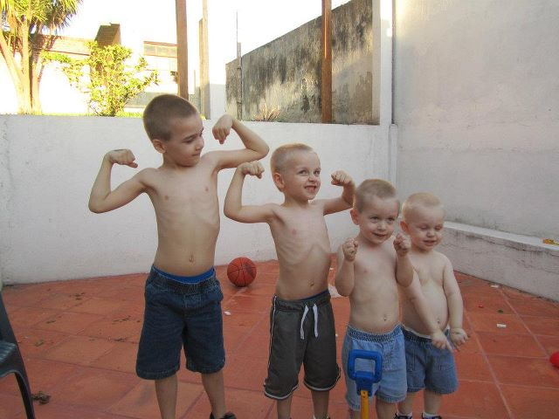
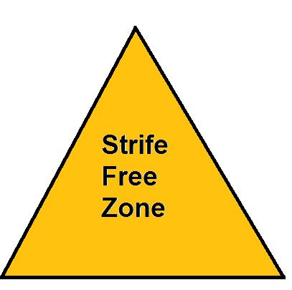
The Servant's Heart
Notice we have moved from a teacher’s heart to a servant’s heart. One can be a teacher and not be a servant. A teacher can give out facts and figures,
but do it without any care to the students. The servant has a desire not only to teach, but to do it in a way that brings the student closer to his Master.
II Timothy 2:24-26
"And the servant of The Lord must not strive; but be gentle unto all men, apt to teach, patient, In meekness, instructing those that oppose themselves, if God peradventure will give them repentance unto the acknowledging of the truth; And that they may recover themselves out of the snare of the devil..."
In these verses, Paul is instructing Timothy on some qualities of a servant of The Lord. It is apparent that a servant of The Lord needs to be filled with The Spirit, for we see some evidences of The Spirit in the above verses. Can you list them?
The servant of The Lord must be to men.
The servant of the Lord must be to teach.
The servant of The Lord must be
The servant of The Lord must be
Zecharia 4:6 “ Not by might, nor by power, but by my spirit, saith The LORD of hosts.”

Slide 15
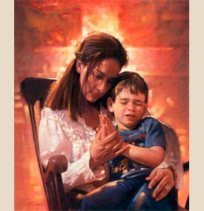
Timothy
Like so many homes today, Timothy’s home was divided. His mother was a believer in Christ, as was his grandmother, but his father was noted as only being a Greek.. What we can learn from Timothy’s life is that Godly influence and love can prevail in even the most difficult situation in the home.
II Timothy 1:1-5
"Paul, an apostle of Jesus Christ by the will of God, according to the promise of life which is in Christ Jesus, to Timothy, my dearly beloved son: Grace, mercy and peace, from God The Father and Christ Jesus our Lord. I thank God, whom I serve from my forefathers with a pure conscience, that without ceasing I have remembrance of thee in my prayers night and day; Greatly desiring to see thee, being mindful of thy tears, that I may be filled with joy; When I call to remembrance the unfeigned faith that is in thee, which dwelt first in thy grandmother Lois, and thy mother Eunice; and I am persuaded that in thee also."
We can learn some valuable lessons from the lives of two women who reaped great rewards from their labor of love shown toward one boy, Timothy.
1. The women's names were ___________________________________________and _________________________________.
2. Their relationship to Timothy was ____________________________and __________________________________________________.
  3. Their testimony was that of having unfeigned ___________________. ("Unfeigned" means "sincere” or "unpretentious".)
A Labor of Love
It is God's Word that convicts and changes hearts.

Slide 16
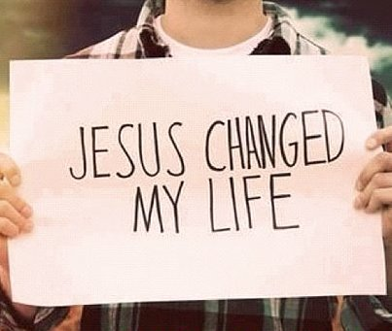


Belief Burdened Blessing
4. These two women had a ________________________ in God. They were born again and taught the Holy Scriptures to Timothy.
5. They were___________________ to teach him the scriptures. There was a void in Timothy's life. It has been said that his earthy father was not a good example for his son. These godly women placed Timothy in the hands of their Heavenly Father. God became a Father to Timothy and did great things in and through his life, eternally recording these events in His Word.
This holds true for each child that comes under our wings, We must show them The Heavenly Father's great love and let them know of His desire to do great things in through their lives.
6. They reaped the benefits of this labor of love by seeing God's _________________________________ on Timothy's life. God chose him to preach The Word and his works are eternally recorded in God's Word, which is preserved forever.
“Lois” means “agreeable”(Origin unknown) Eunice is a Greek name and means-“good victory” derived from Nike, the Greek goddess of victory.
Promises from God's Word
Proverbs 22:6
"Train up a child in the way
he should go: and when he
is old, he will not depart from it."
Isaiah 55:11
"So shall My word be that goeth forth out
of My mouth: it shall not return unto Me void,
but it shall accomplish that which I please,
and shall prosper in the thing whereto
I sent it."
Discussion time: What does God use to change our lives?

Slide 17



Rise and shine for Jesus!
Luke 22:46
“And said unto them, Why sleep ye? Rise and pray, lest ye enter into temptation.”
II Timothy 2:15
“Study to shew thyself approved unto God, a workman that needeth not to be ashamed, rightly dividing the word of truth.”
Mark 6:31
“And He said unto them, Come ye yourselves apart into a desert place, and rest a while:..”
The enemies of the Christian are the world, the flesh and the devil.
Each will try to distract the servant of God from rest, study and prayer.

Slide 18
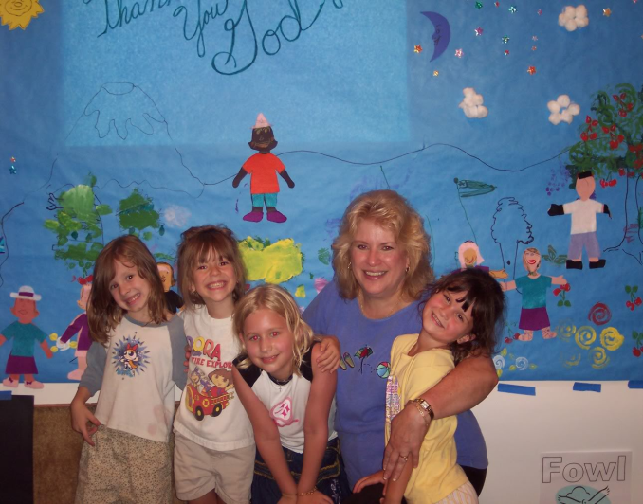





Question and answer time
The things mentioned from my few visits to Sunday School are the things that are still needed in classes today to draw the child to Jesus. (Refer to page 5)
Answer these questions:
Attendance sheets make a great prayer list!
1. Do I pray for the children with whom I minister? (James 5:16)
2. Do I make them all feel welcome? Do I smile? (Ephesians 4:32)
3. Do I sing joyful songs that stay in the heart? (Psalm 100:1 and 2)
4. Do I allow them to see the Bible verses, whether in the Bible or written somewhere? Psalm 119:105
5. Do I use my Bible, allowing those who can't read to can hear The Word of God? (Jeremiah 15:16)
6. Am I prepared to teach...filled with The Spirit? (Ephesians 5:18)
7. Is it possible that I have sufficient helpers for my class?
8. In all that I do, do I point the children to Jesus? He has the master plan for their lives. (John 12:32)
9. Do I give an opportunity, after each lesson, for a child to accept Christ as their Savior,
knowing this may be their only chance to do so? (Proverbs 27:1) (Psalm 95:7)
10. Do I have a genuine love in my heart for the children? Do I love them unconditionally? (Proverbs 10:12) (Jeremiah 31:3)

Slide 19
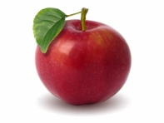

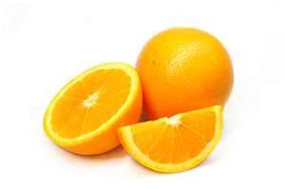

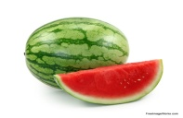
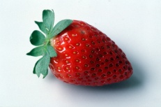

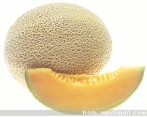
Hindrances to an effective teaching ministry..
II Timothy 2:21 "If a man therefore purge himself from these, he shall be a vessel unto honor, sanctified and meet for The Master's use, and prepared unto every good work."
Before one can be filled with The Spirit one must be emptied of self. To be emptied of self, one agrees that they are not entitled to personal opinions or ideas. They teach God’s Word, God’s Way, for His purposes.
“..it is not enough that we cease to do evil, but we must learn to do well.” Matthew Henry
Works of the flesh
Adultery
Fornication- impurity between unmarried persons,
and for all kinds of infidelity to God
uncleanness
lasciviousness -unrestrained behavior
Idolatry
witchcraft
hatred
variance (arguer)
emulations (jealous competition)
wrath
strife
seditions -rebellion against authority
heresies -stating opposing opinion to divide
envyings
murders
drunkenness
revellings -rebellious acts
Works of The Spirit
love-people are drawn to a loving person
joy- lasting; happiness is circumstancial
peace
longsuffering
gentleness
goodness
faith- trusting God, even when we don't understand
meekness
temperance- self control
Galatians 5:19-23
“Now the works of the flesh are manifest, which are these; Adultery, fornication, uncleanness, lasciviousness,
Idolatry, witchcraft, hatred, variance, emulations, wrath, strife, seditions, heresies, Envyings, murders, drunkenness, revellings, and such like: of the which I tell you before, as I have also told you in time past, that they which do such things shall not inherit the kingdom of God. But the fruit of the Spirit is love, joy, peace, longsuffering, gentleness, goodness, faith, Meekness, temperance: against such there is no law.”
Not only are we to be filled with The Spirit, we are to operate in The Spirit.
The biggest hindrance in a Christian’s life is not others or the devil, it is one’s self ..the flesh.
Purpose in life..for God’s glory!
have someone to love.
have something to do.
They can be found in Christ and His church.
God doesn’t expect His children to do what He has not enabled them to do. But we are accountable to use the gifts He has given and we all have at least one.
Read Romans 12:6-8

Slide 20



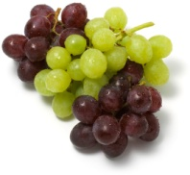
Things to put off - Things to put on
Ephesians 4:22 “That ye put off concerning the former conversation the old man, which is corrupt according to the deceitful lusts;
Romans 13:12 -14 “The night is far spent, the day is at hand: let us therefore cast off the works of darkness, and let us put on the armor of light. Let us walk honestly, as in the day; not in rioting and drunkenness, not in chambering and wantonness, not in strife and envying. But put ye on The Lord Jesus Christ, and make not provision for the flesh, to fulfill the lusts thereof.”
Colossians 3:8 and 9 “But now ye also put off all these; anger, wrath, malice, blasphemy, filthy communication out of your mouth. Lie not one to another, seeing that ye have put off the old man with his deeds;”
Colossians 3:10-14
“And have put on the new man, which is renewed in knowledge after the image of him that created him: Put on therefore, as the elect of God, holy and beloved, bowels of mercies, kindness, humbleness of mind, meekness, longsuffering; And above all these things put on charity, which is the bond of perfectness.”
John 15:8
“Herein is My Father glorified, that ye bear much fruit; so shall ye be My disciples.”
Questions
According to John 15:8, what glorifies God in a believer’s life? How do others know that we are His disciples?
______________________________________________________________________________________________________________________________________________________________________________________________________________________________________________________________________________________________________________________________________________________________________________________________________________________________________________________________________________________________________________________________________________________________________________________________________________________________________________________

Slide 21
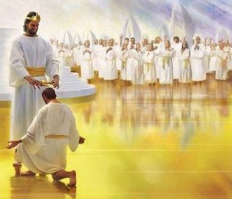
The goal of every Spirit filled teacher is to hear these words..
Look up Matthew 25: 21 and write it below.
______________________________________________________________________________________________________________________________________________________________________________________________________________________________________________________________________________________________________________________________________________________________________________________________________________________________________________________________________________________________________________________________________________________________________________________________________________________________________________________

Slide 22
Sunday School
Class Schedule
Having the announcements
in the beginning allows time
for the late children to arrive
before Bible time.
Children’s prayer time
encourages the children
to give all their cares and
praises to The Lord.
Activity Time Date
Assembly/announcements 5
Children’s prayer time 5
Offering 5
Song time 10
Teacher’s prayer time 5
Bible time 5
Application (story)/Invitation 20
-
Offering is an opportunity
to for the children to practice
their giving and serving.
Song time should be
all about Jesus!
The invitation should always be
Spirit-led, giving time for children
to accept Christ and for those who
know Him to confess sin or follow
Him in service.
Teacher should acknowledge
his or her dependence on
The Lord as she teaches the
children.
Children should see the teacher read
the Bible. To help those who come
to class without one, have extra Bibles to
lend. You can also write the verse on
a board.

Slide 23
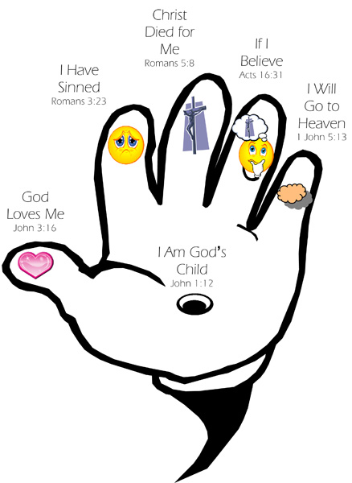
John 3:16 “For God so loved the world, that He gave His only begotten Son, that whosoever believeth in Him should not perish, but have everlasting life.”
John 3:17 For God sent not His Son into the world to condemn the world; but that the world through Him might be saved.”

Slide 24

Questions-preguntas

