Slide 1
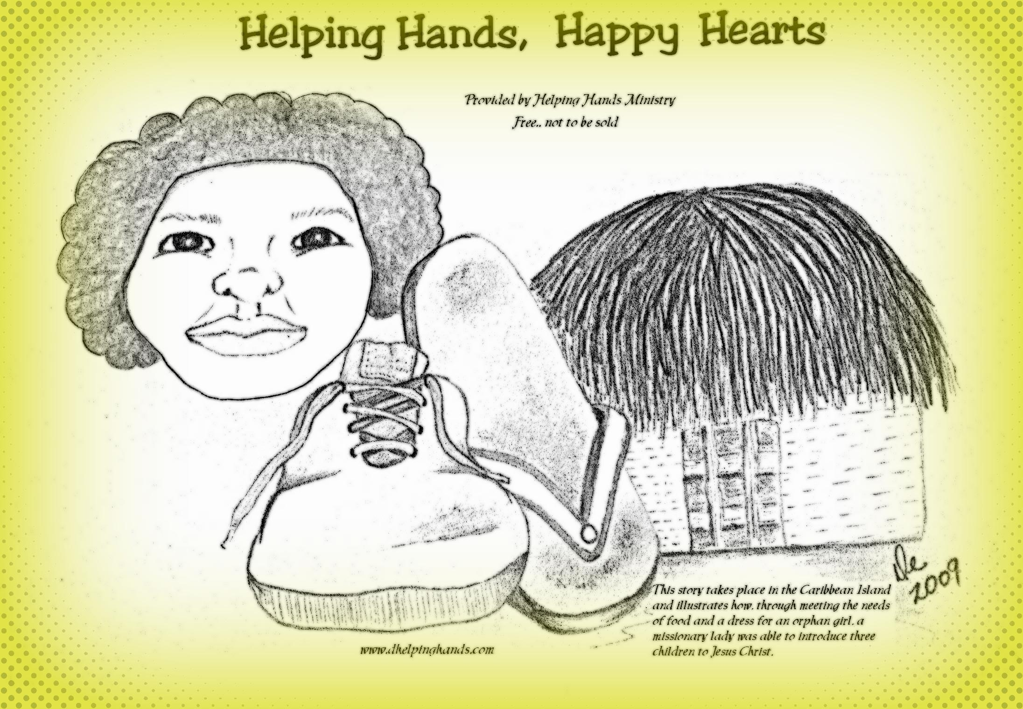
Power Point Provided by Helping Hands Ministry

Slide 2


Slide 3
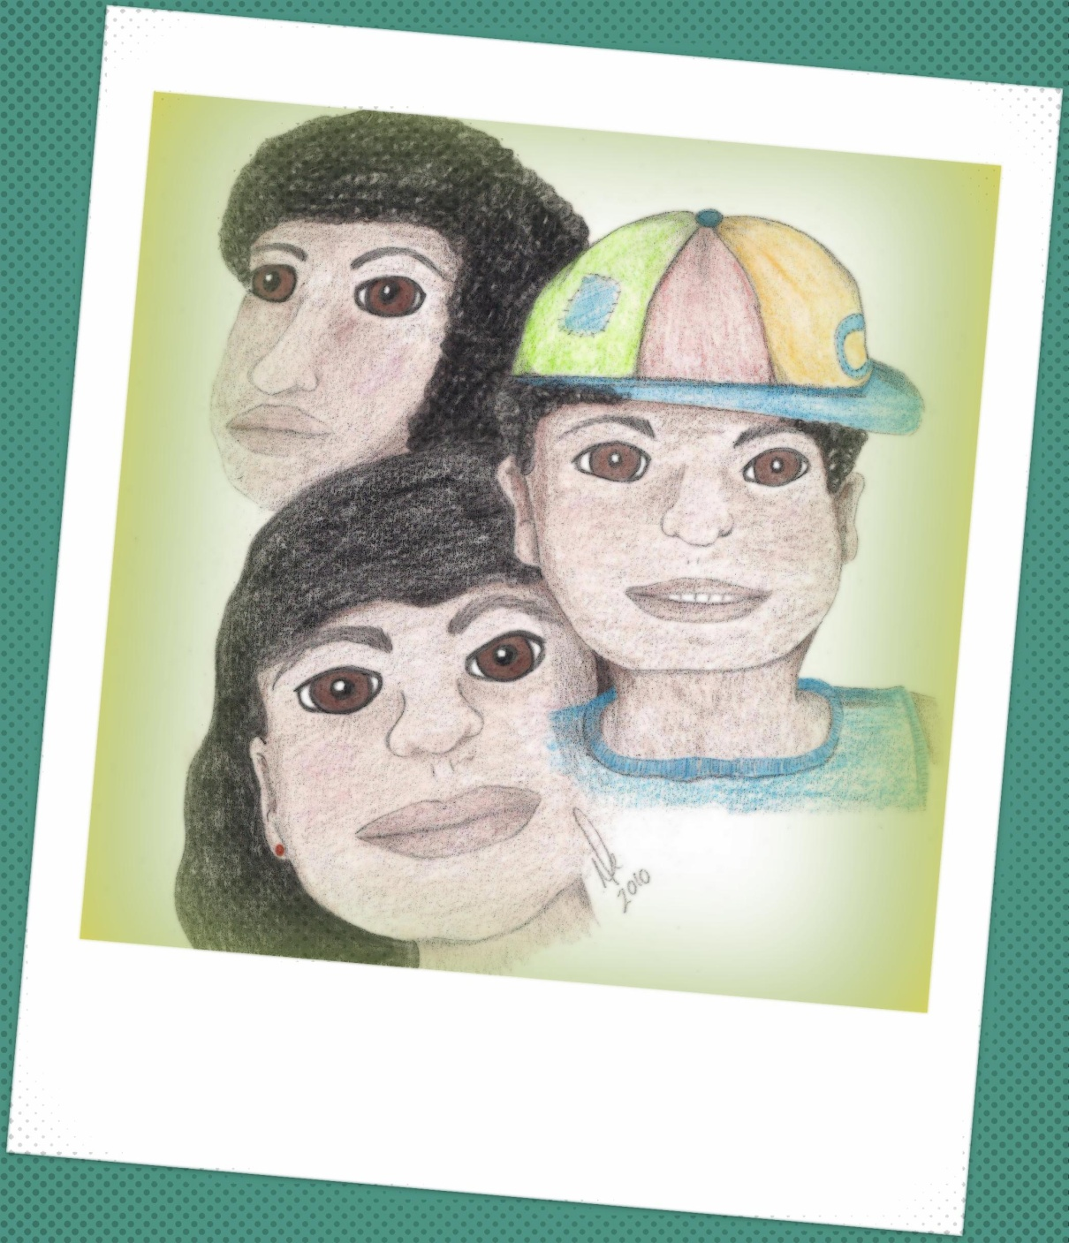

Slide 4
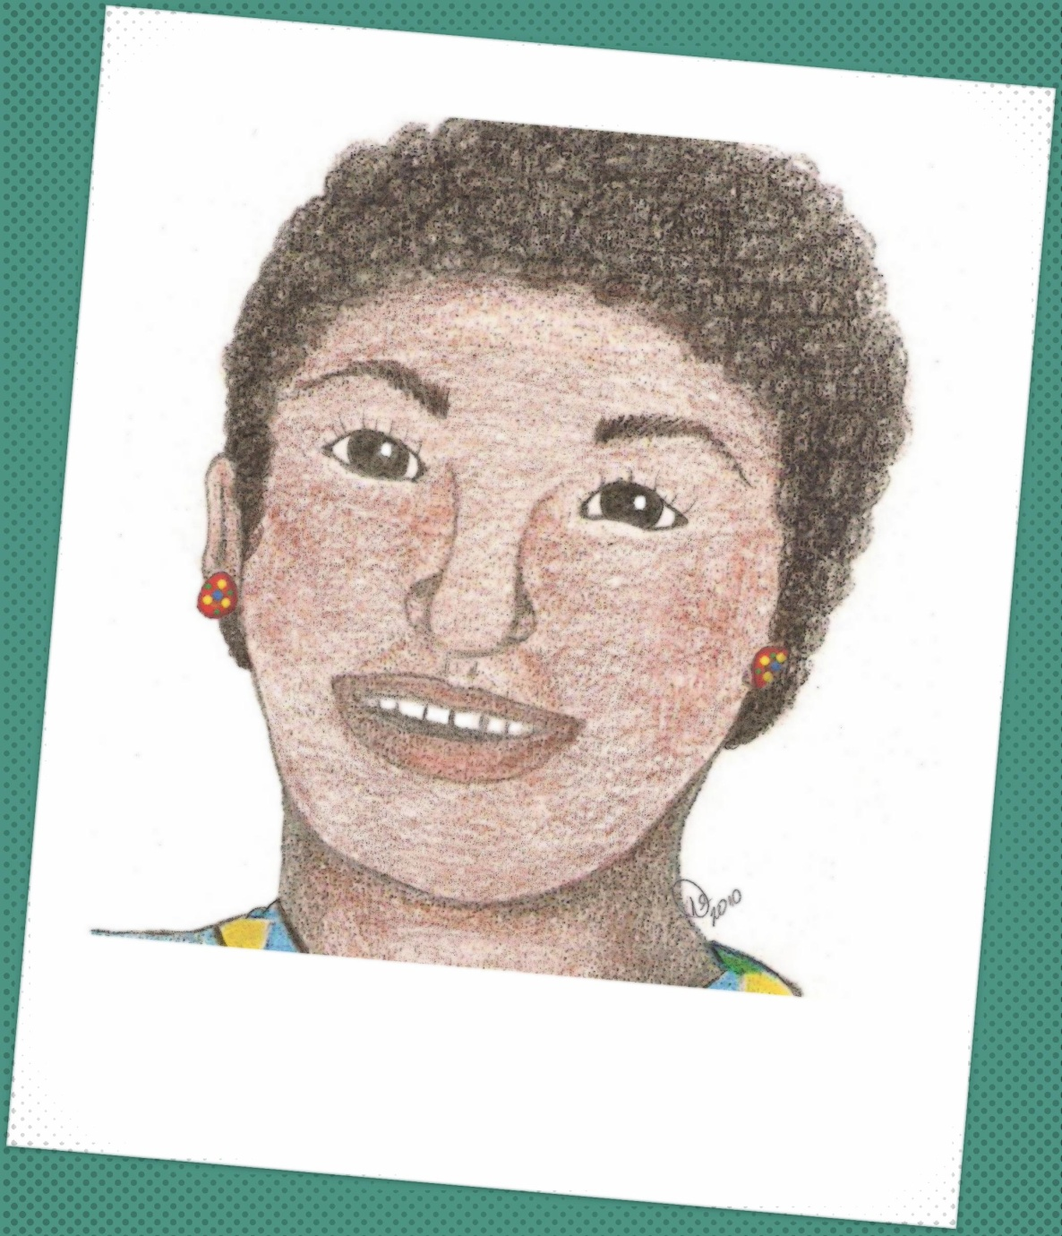

Slide 5
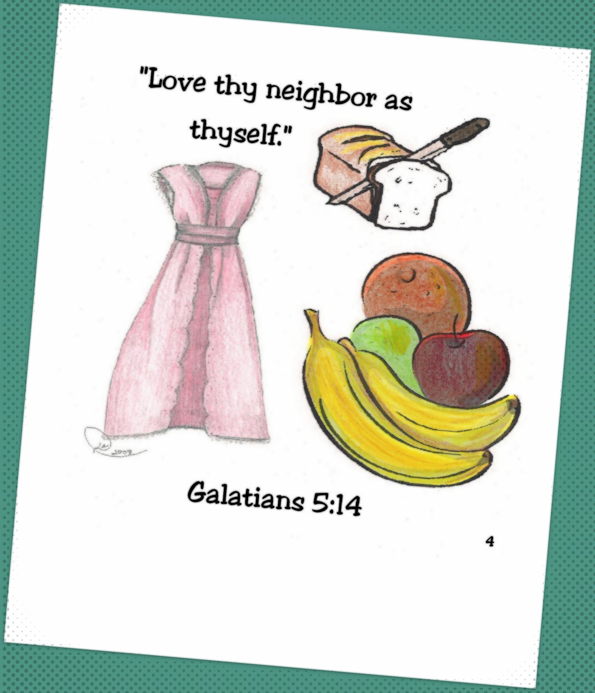

Slide 6


Slide 7
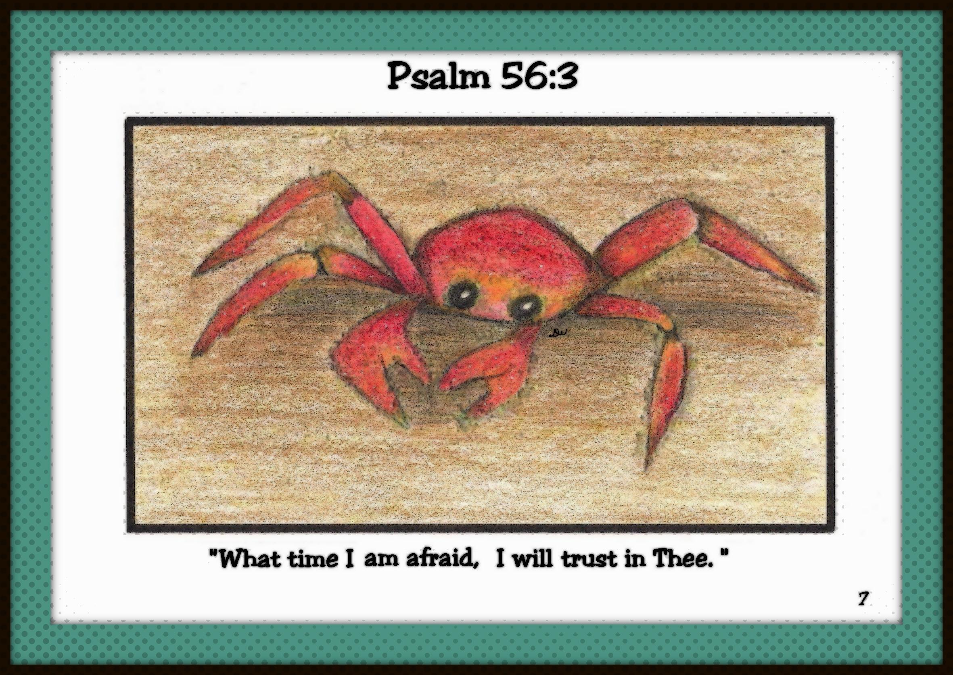

Slide 8
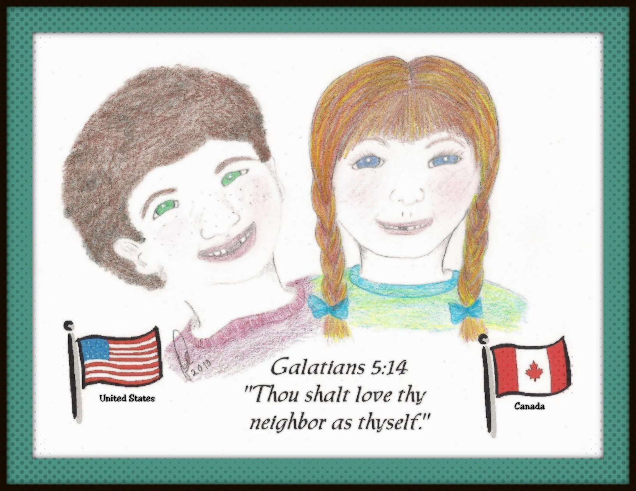

Slide 9
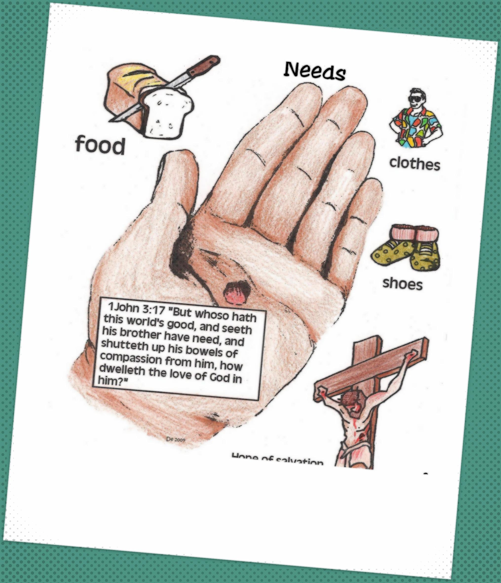

Slide 10
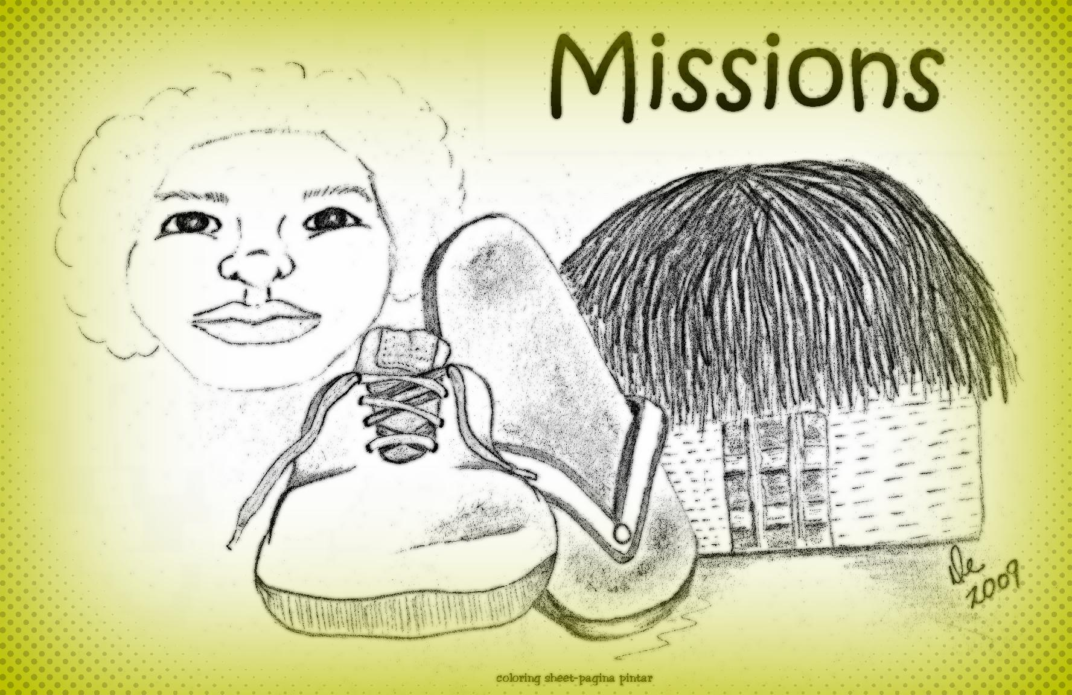
Matthew 25:40
“And The King shall answer and say unto them, Verily I say unto you,
Inasmuch as ye have done it unto one of the least of these My brethren,
ye have done it unto Me.”

