Slide 1
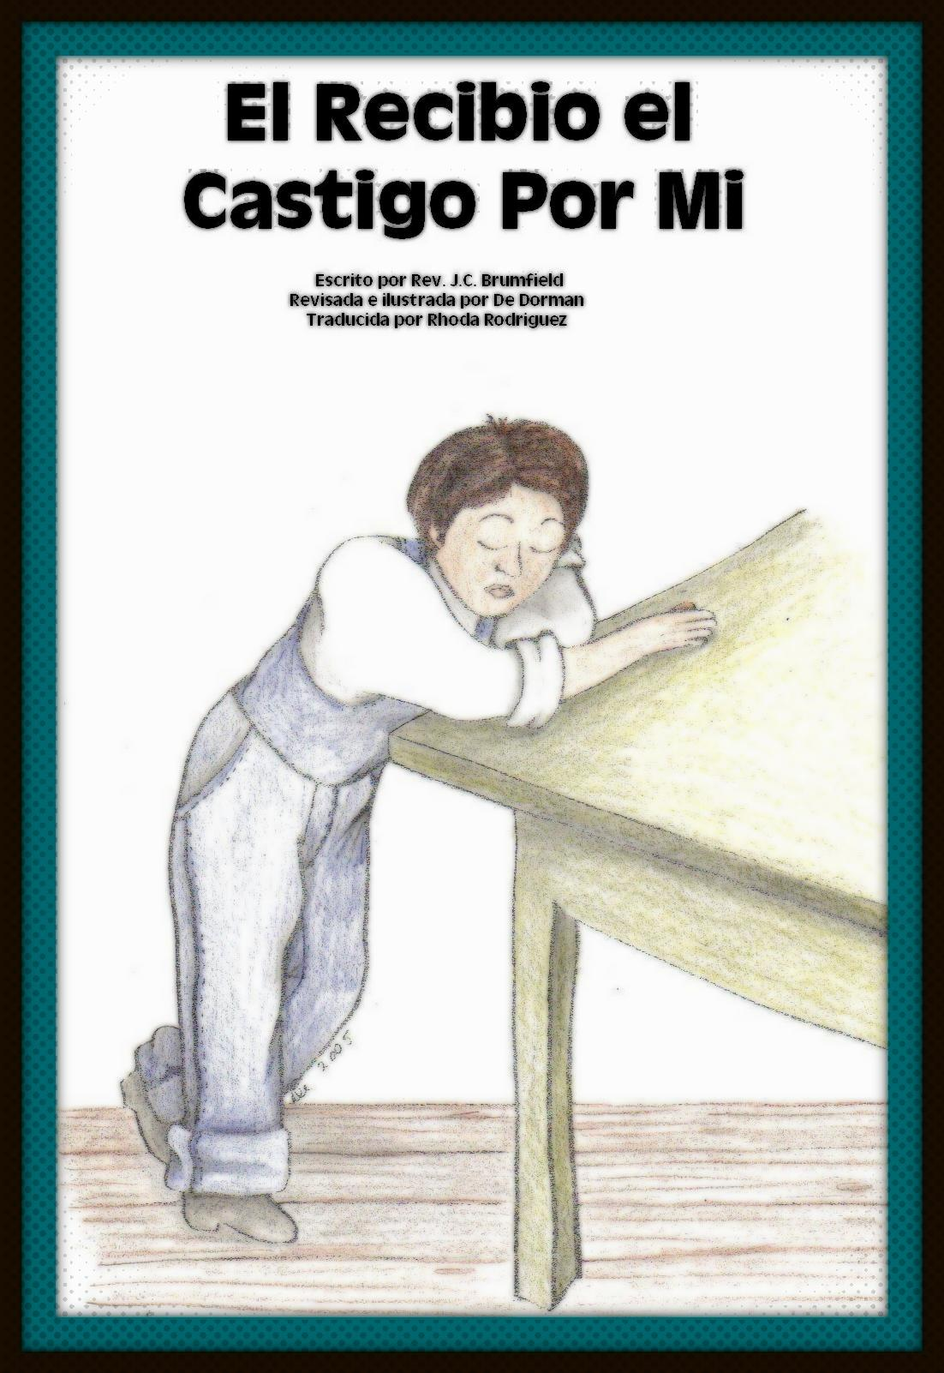
Power Point
provided by
Helping
Hands Ministry

Slide 2
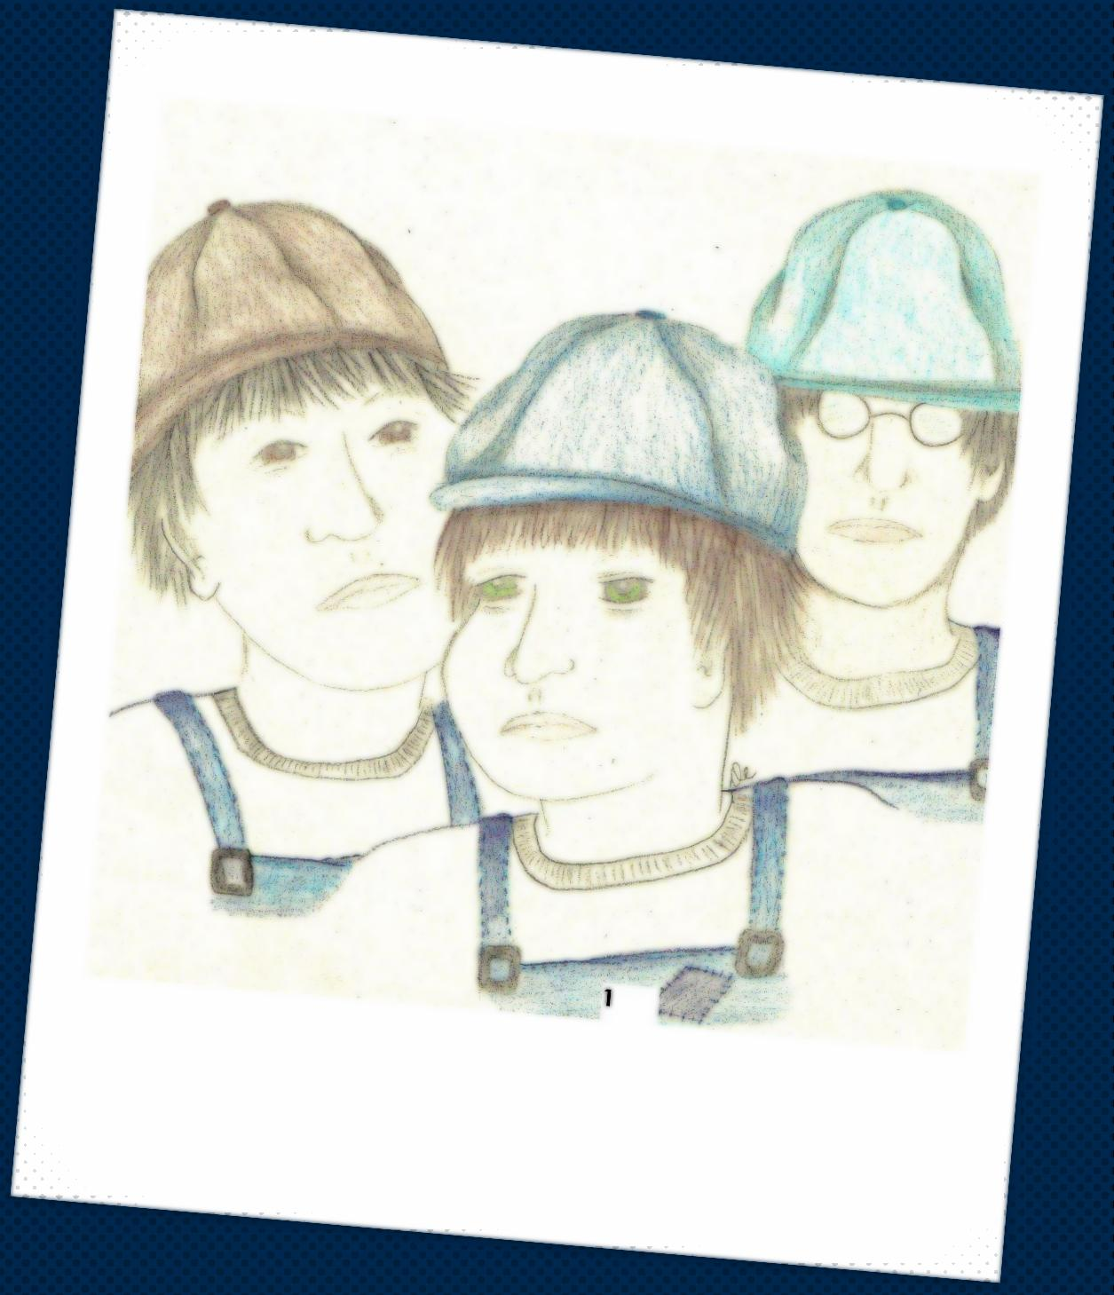

Slide 3
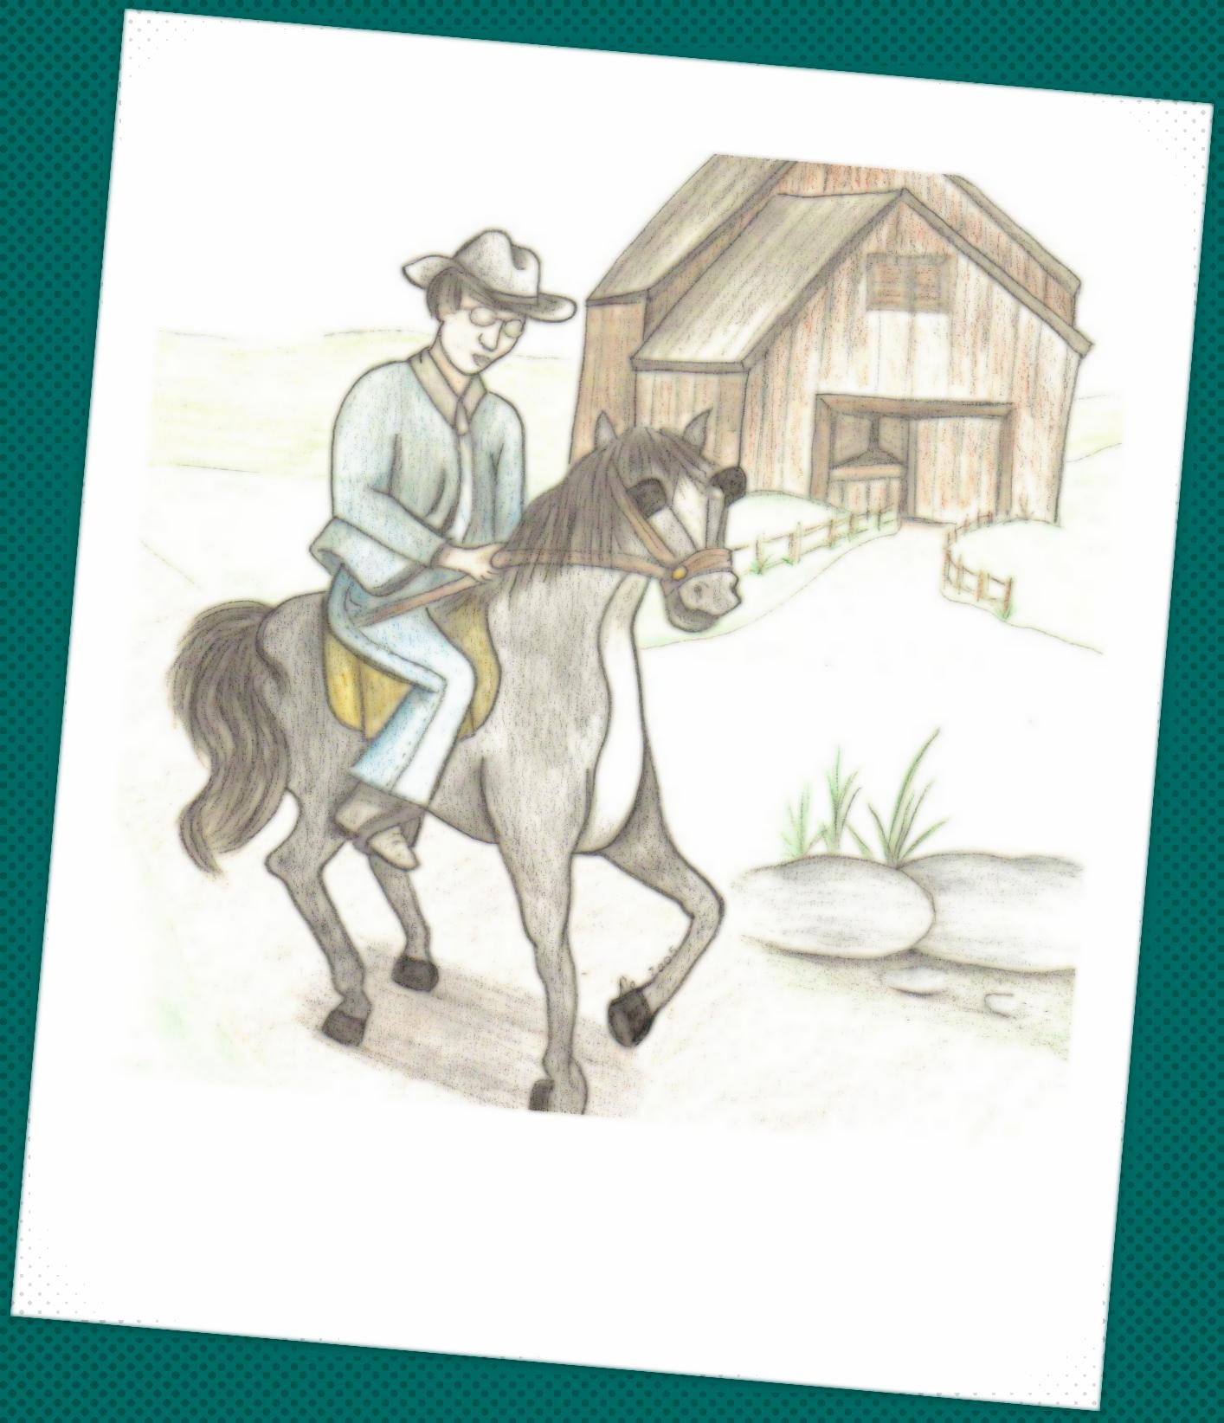

Slide 4
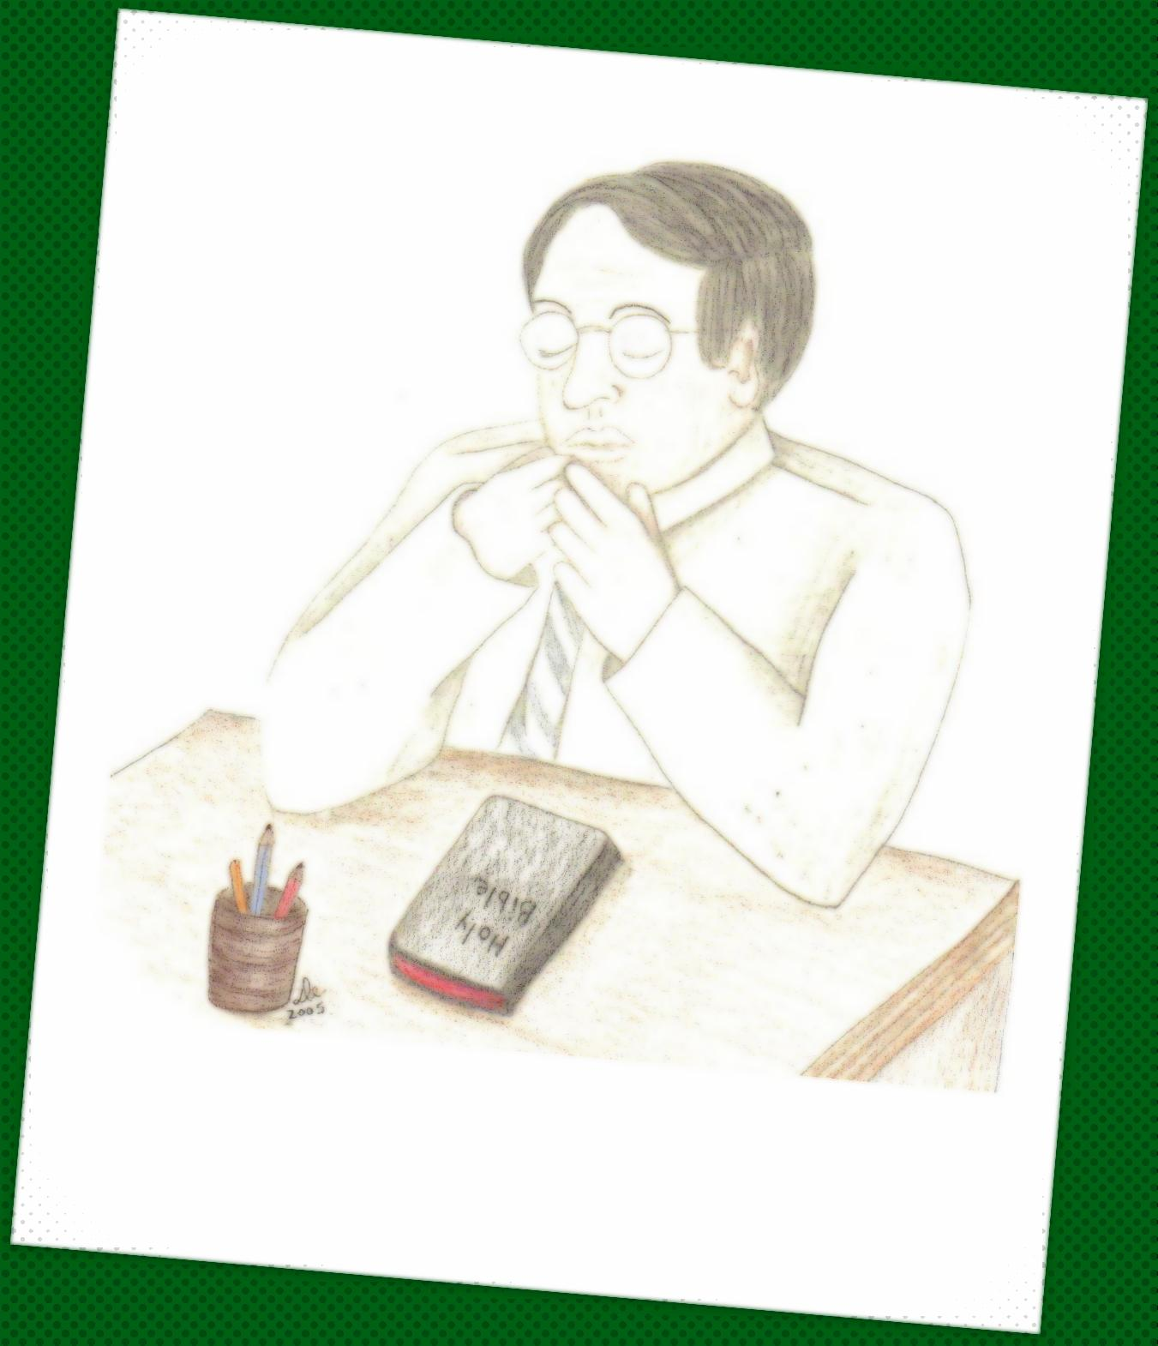

Slide 5
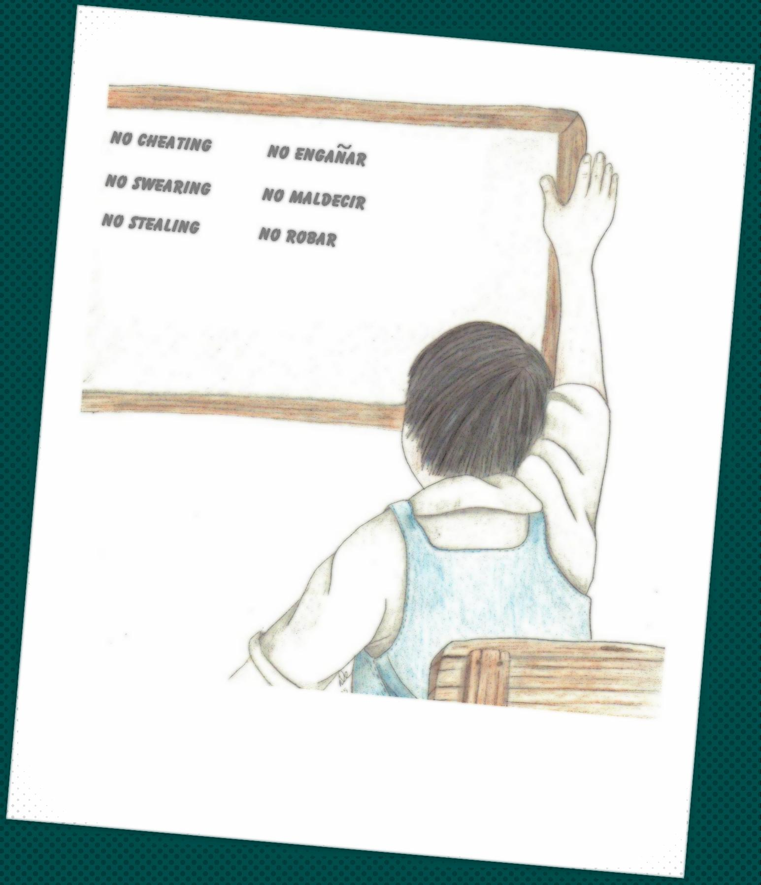

Slide 6
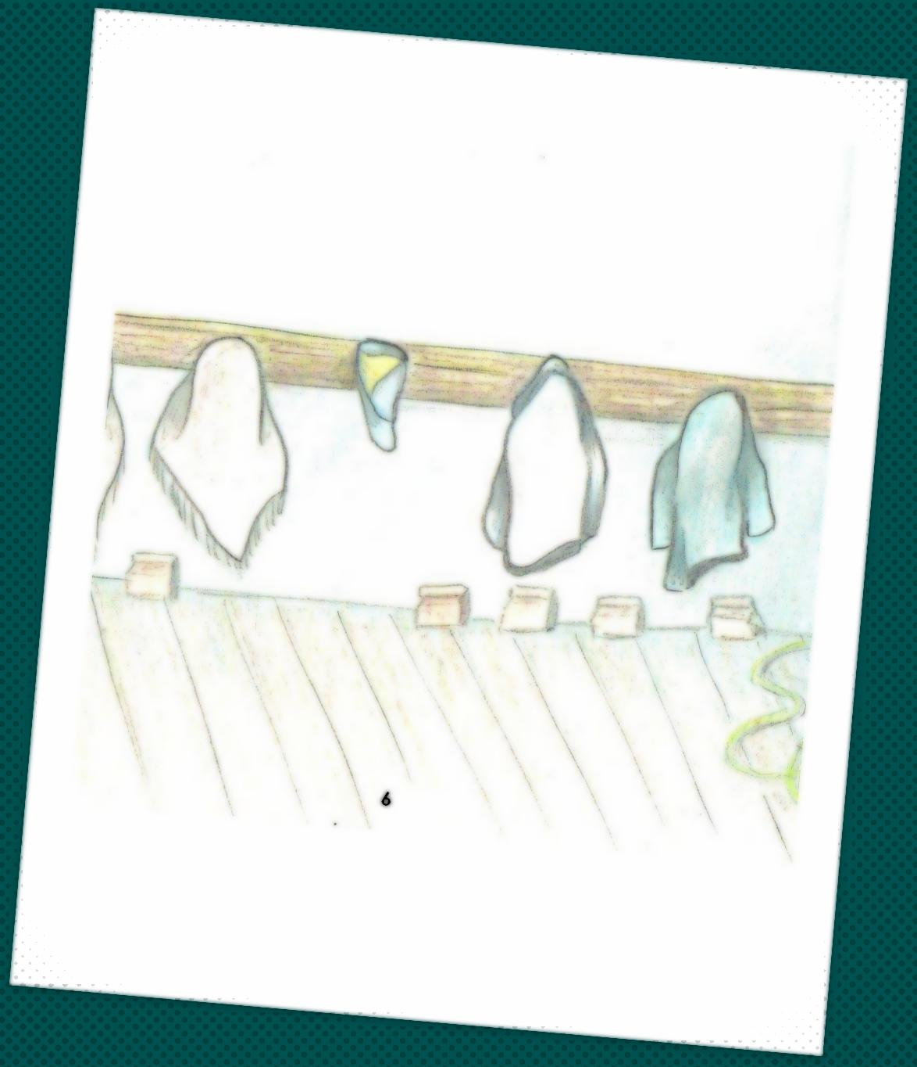

Slide 7
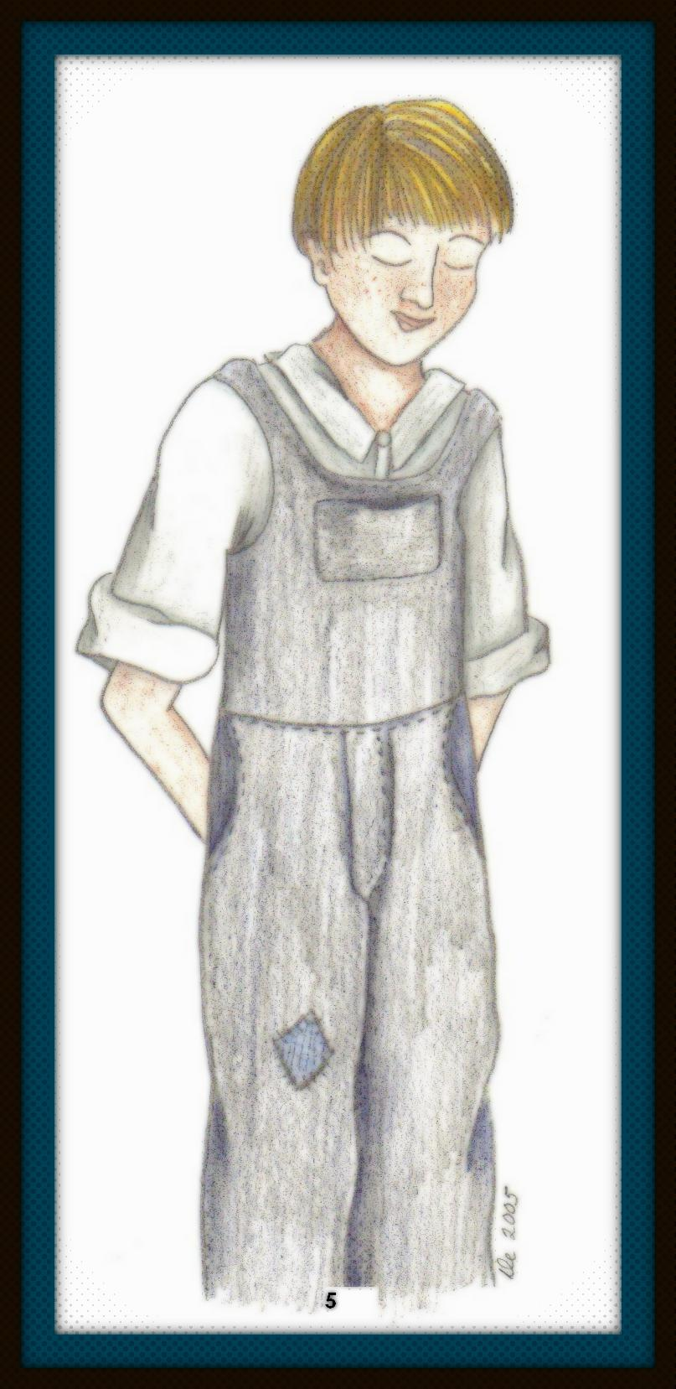

Slide 8
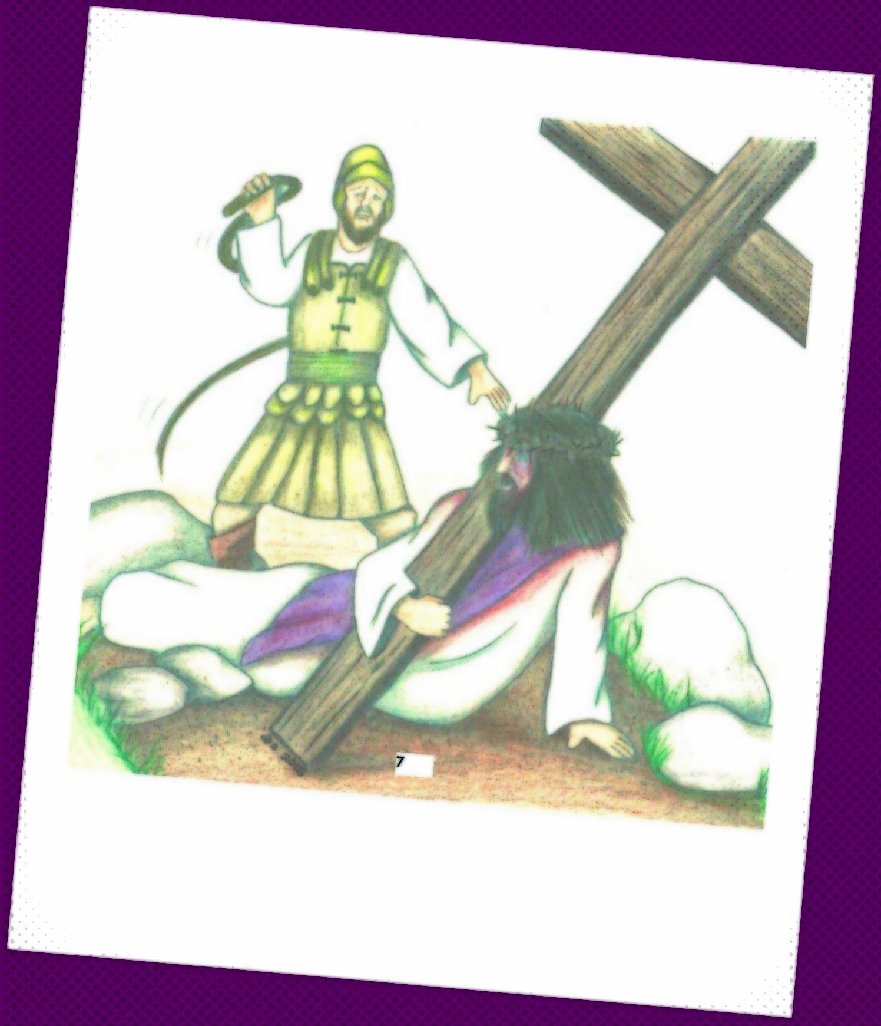

Slide 9
Isaiah 53:5
“But He was wounded
for our transgressions,
He was bruised
for our iniquities:
the chastisement of our peace
was upon Him;
and
with His stripes we are healed.”

Slide 10
Isaiah 53:5
Mas Él herido fué por nuestras rebeliones, molido por nuestros pecados: el castigo de nuestra paz sobre Él; y por Su llaga fuimos nosotros curados.”

